Slide 1
Properties and Types of Sensory Receptors
The General Senses; The Chemical Senses

Slide 2
Learning outcomes:
Define receptor and sense organ;
list the four kinds of information obtained from sensory receptors, and describe how the nervous system encodes each type;
outline three ways of classifying receptors.
list several types of somatosensory receptors;
describe the projection pathways for the general senses;
explain the mechanisms of pain and the spinal blocking of pain signals;
explain how taste and smell receptors are stimulated;
identify in the picture; describe the receptors and projection pathways for these two senses
Describe the receptor cells for taste and smell and identify their anatomical locations;
Identify the five primary taste sensations and the chemicals that produce them;
Discuss factors other than taste that contribute to the flavor of food;
Identify the brain regions that process gustatory and olfactory information.

Slide 3
Definitions
A sensory receptor is any structure specialized to detect a stimulus. Some receptors are simple, bare nerve endings, such as the receptors for heat and pain, while others are true sense organs.
A sense organ is a structure composed of nervous tissue along with muscular, epithelial, or connective tissues that enhance the organ’s response to a certain type of stimulus.
Sense organs can be as complex as the eye and ear or as microscopic and simple as a dendrite wrapped in a little connective tissue.
Sensation - the subjective awareness of a stimulus.

Slide 4
most sensory signals delivered to the CNS produce no conscious sensation at all.
Sensory receptors provide the CNS with four kinds of information about a stimulus—
type, location, intensity, and duration

Slide 5
1. Type (modality)
vision, hearing, taste, and pain, etc.
finer differences within these major categories—a red or blue color or a bitter or sweet taste, for example.

Slide 6
2. Location
Any sensory neuron detects stimuli within an area called its receptive field.
(a) One large receptive field (arrow)
(b) Three small receptive fields (arrows)

Slide 7


3. Intensity
refers to whether a sound is loud or soft, a light is bright or dim, a pain is mild or excruciating, and so forth.

Slide 8
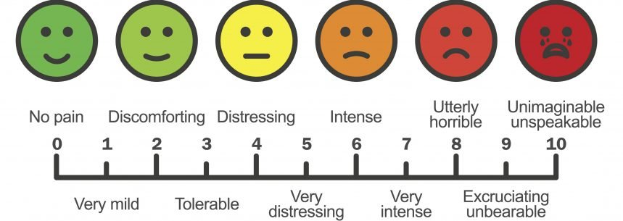
3. Intensity

Slide 9
4. Duration
how long a stimulus lasts, is encoded by changes in the firing frequency of a nerve fiber with the passage of time. All receptors exhibit the property of sensory adaptation.

Slide 10


Slide 11
We can think of all sense organs as transducers—devices that convert one form of energy (light, heat, chemicals, touch, sound) into another (action potentials). The process of converting stimulus energy to nerve energy is called sensory transduction.
There are multiple ways of classifying the senses and receptors.

Slide 12
Senses and receptors
General senses
distributed over much or all of the body
  in the skin, muscles, tendons, joints, and viscera
Special senses
limited to the head and employ receptors that are innervated by the cranial nerves.
  taste, smell, hearing, equilibrium, and vision.

Slide 13
Senses and receptors
General senses
distributed over much or all of the body
  in the skin, muscles, tendons, joints, and viscera
Special senses
limited to the head and employ receptors that are innervated by the cranial nerves.

Slide 14
Receptors for the General (Somatosensory) Senses.
Hair receptor
Free nerve endings
Tactile corpuscle
Tactile disc
Lamellar corpuscle

Slide 15
Free nerve endings
include warm receptors that respond to rising temperatures, cold receptors that respond to falling temperatures, and nociceptors (NO-sih-sep-turs) that produce pain sensations in response to tissue injury.
Free nerve endings are especially abundant in the skin and mucous membranes.

Slide 16
Tactile discs
are receptors for light touch that are employed for detecting textures, edges, and shapes. They are flattened nerve endings that terminate adjacent to a specialized tactile cell at the base of the epidermis. Compression of the tactile cell releases a chemical signal that excites the associated nerve fiber.

Slide 17
Tactile discs
Hair receptors are dendrites that coil around a hair follicle and respond to movements of the hair. They are stimulated when, for example, an ant walks across one’s skin, bending one hair after another. However, they adapt quickly, so we are not constantly irritated by the feel of clothing against the skin. Hair receptors are particularly important in the eyelashes, where the slightest touch triggers a protective blink reflex.

Slide 18
Tactile corpuscles
like tactile discs, are receptors for light touch and texture and are found in the dermal papillae at the boundary between the dermis and epidermis. Each consists of two or three nerve fibers meandering upward through a tall mass of flattened Schwann cells. They are especially concentrated in sensitive hairless areas such as the fingertips, palms, eyelids, lips, nipples, and genitals. Drag a fingernail lightly across the back of your hand, then across your palm. The difference in sensation that you feel is due to the high concentration of tactile corpuscles in the palmar skin. Tactile corpuscles enable you to tell the difference between satin and sandpaper, for example, by light strokes of your fingertips.

Slide 19
Tactile corpuscles
Lamellar corpuscles are sensitive to deep pressure, stretch, tickle, and vibration.
They are 1 or 2 mm long and visible to the naked eye. In cross section, they look like an onion slice, with the nerve fiber at the core surrounded by layers of flattened Schwann cells and fibroblasts. They are especially abundant in the periosteum of bone, joint capsules, the pancreas and some other viscera, and deep in the dermis, especially in the hands, feet, breasts, and genitals.

Slide 20
Pain
is discomfort caused by tissue injury or noxious stimulation; it typically leads to evasive action.
one of our most important and purposeful senses and we would be far worse off without it.
Nociceptors, which respond to chemicals released by injured tissues. They are especially dense in the skin and mucous membranes and occur in nearly all organs

Slide 21

Nociceptors are absent from the brain.

Slide 22
Pain from the skin, muscles, and joints is called somatic pain.
Pain from the internal organs of the body cavities is called visceral pain.
Three fascinating aspects of pain are referred pain, phantom pain, and spinal gating of pain.

Slide 23
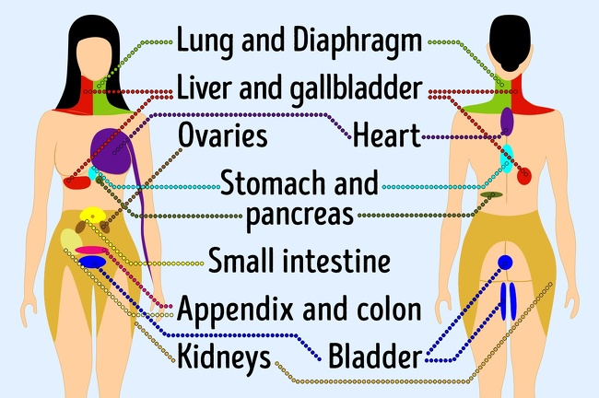
Referred pain

Slide 24
Referred pain
pain fibers from the heart and skin converge on the same neurons in the central nervous system, so by the time these signals get to the pain centers of the brain, the brain cannot identify their source. Of these two, the skin is more frequently injured, so the brain acts as if it “assumes” that the pain most likely comes from the skin.

Slide 25
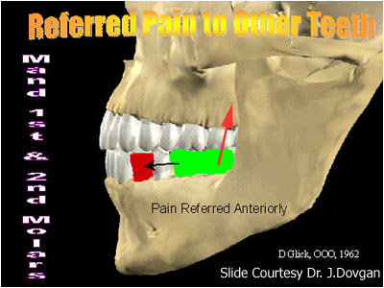

Slide 26
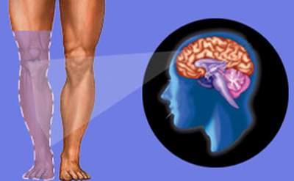
Phantom pain

Slide 27
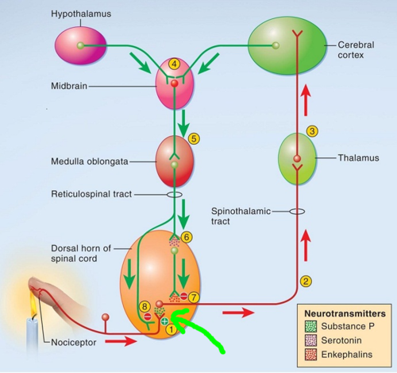
Spinal gating

Slide 28
Chemical senses
Chemoreceptors are organs and nerve endings that detect chemicals; they include receptors in some arteries for monitoring blood chemistry, and our organs of taste and smell.

Slide 29
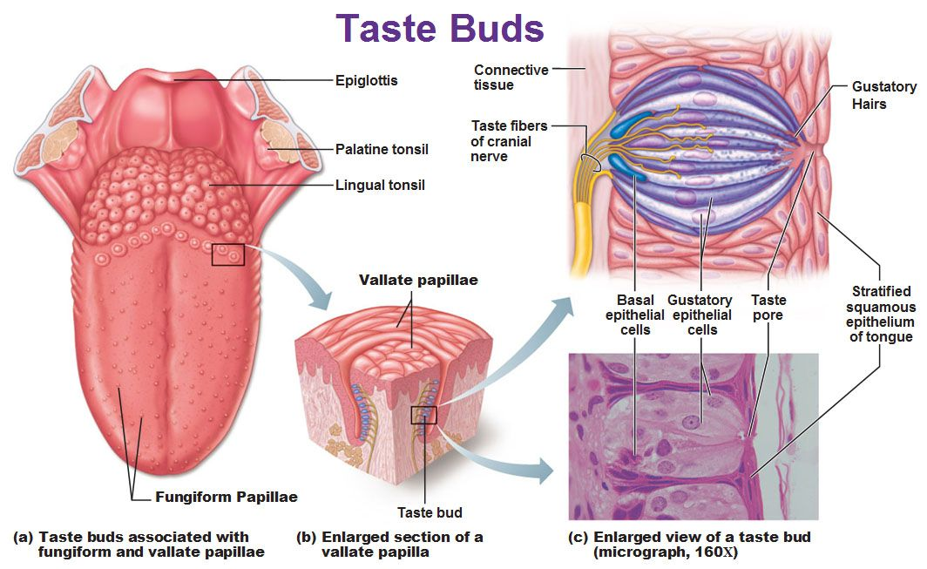
Gustation—The Sense of Taste

Slide 30
five primary taste sensations
Salty, produced by metal ions such as sodium and potassium. Electrolyte deficiencies can cause a person or animal to crave salty food.
Sweet, produced by sugars and many other organic compounds and usually associated with high-calorie foods.
Sour, produced by the acids in such foods as citrus fruit.
Bitter, produced by organic alkaloid compounds such as nicotine, caffeine, and quinine, and associated with plant toxins and spoiled foods. The bitter sensation probably served in evolution as a warning not to ingest a substance, but many people cultivate a liking for certain bitter foods and drinks, such as capers and tonic water.
Umami (pronounced “ooh-mommy”), a meaty taste produced by amino acids such as aspartic and glutamic acid and by monosodium glutamate (MSG), a glutamic acid salt widely used as a flavor-enhancing food additive.

Slide 31
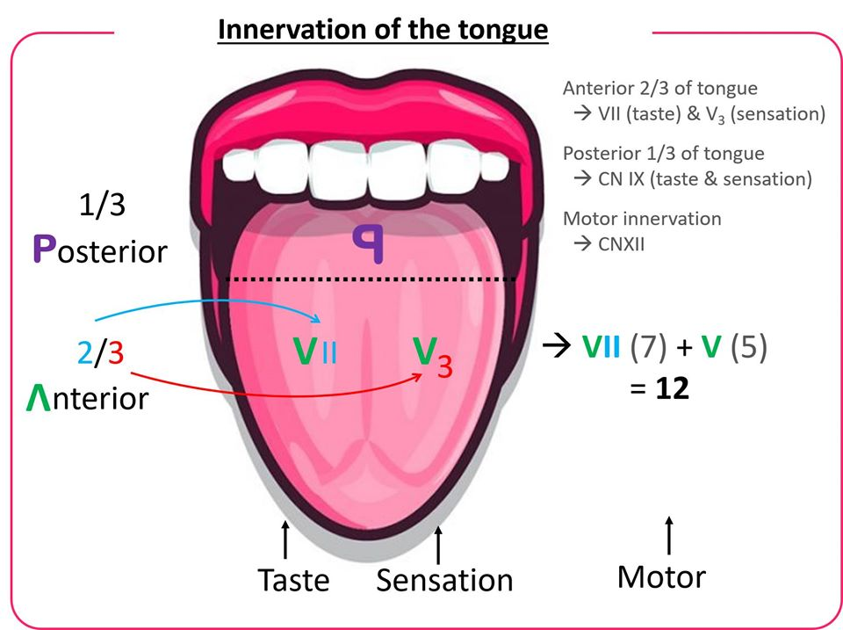
https://www.youtube.com/watch?v=uzmLClRMVN0&feature=share&fbclid=IwAR3CWL9GTk70hEP4W64v1tw9kfDX60hvtoiwKKfMeSeUFv5gVz8C_1CzvKg

Slide 32
Olfaction—The Sense of Smell
Olfaction, the sense of smell, is a response to airborne chemicals (odorants).
The mucosa measures about 5 cm2 and consists of 10 to 20 million olfactory cells, nonsensory supporting cells and basal cells, and mucus-secreting olfactory glands. Olfactory cells are true neurons, unlike taste cells.
They have a swollen tip bearing 10 to 20 cilia called olfactory hairs, a bulbous body containing the nucleus, and a basal end that tapers to a thin axon leading to the brain. Being the only neurons directly exposed to the external environment, they live only about 60 days and are continually replaced by dividing basal cells.

Slide 33
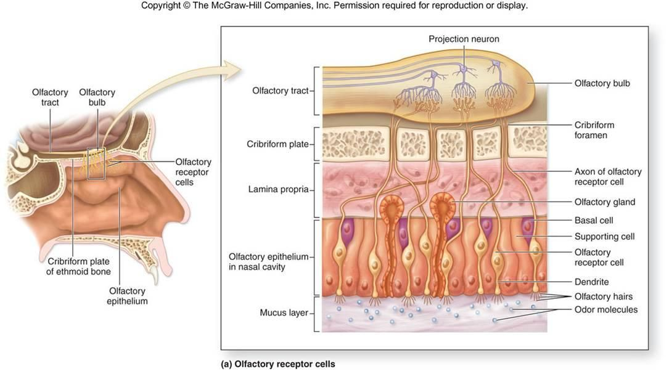
olfactory tracts relay signals to multiple destinations in the cerebrum and brainstem, especially
the primary olfactory cortex in the temporal lobe.

